Slide 1
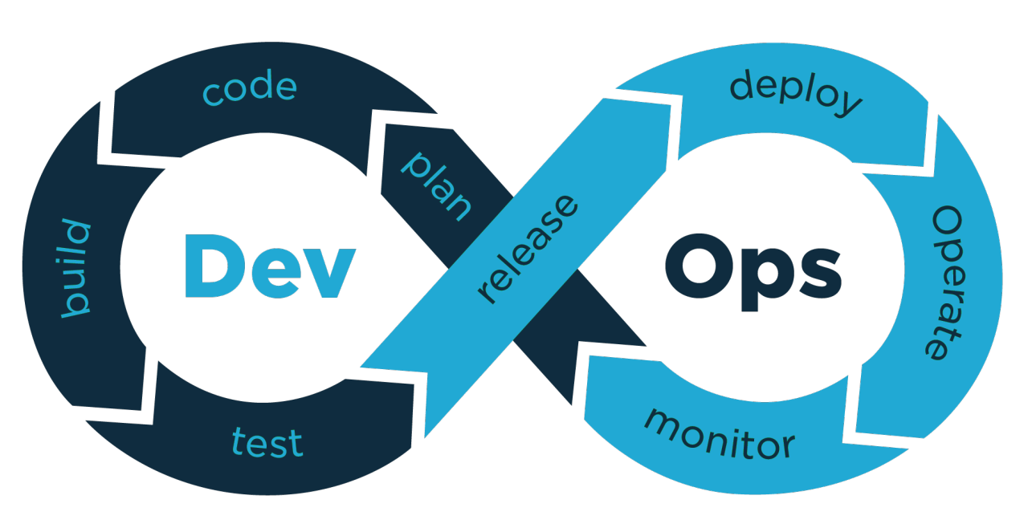
Final Graduation project 2024
Automated Deployment Pipeline with Jenkins, terraform, ansible and K8s

Slide 2




Agenda
Objective.
Tools and Technologies Used.
Prerequisites
Continuous integration
Continuous deployment

Slide 3
objective
This project sets up a CI/CD pipeline for a Java application using Jenkins, Docker, Terraform, Kubernetes, ansible and AWS. The pipeline automates building the Java application, creating a Docker image, pushing it to Docker Hub, and deploying it to a Kubernetes cluster on AWS.

Slide 4
Tools and Technologies Used
Jenkins: CI/CD automation server
Git: Version control system.
Docker: Containerization platform for consistent deployments
Terraform: Infrastructure as Code (IaC) for provisioning AWS resources
AWS: Cloud provider for managing infrastructure
Ansible: Automation for infrastructure and app configuration
Kubernetes: for container orchestration

Slide 5
Prerequisites
Jenkins:
Jenkins installed and running .
Jenkins agents configured to run Docker commands and Terraform scripts.

Slide 6
Prerequisites
AWS Account:
Access credentials (AWS Access Key ID and Secret Access Key).
Terraform AWS provider setup with appropriate permissions to create resources (VPC, subnets, EC2 instances, etc.).

Slide 7
Prerequisites
Docker Hub Account:
Docker Hub credentials stored in Jenkins as a credential named (docker-hub).

Slide 8
Prerequisites
Terraform:
Terraform installed on Jenkins agents to provision infrastructure.

Slide 9
Prerequisites
openJDK and maven:
openJDK and maven installed on Jenkins agents to test and package the app .

Slide 10
pipeline continuous integration
Set Up New Jenkins Job:
Integrate Git repository for automatic builds on code commits.
Configure webhooks to trigger builds automatically upon code changes.
Test Steps:
tests ensure the application functions as expected.
Build Steps:
Build application (using maven).
Post-Build Actions:
Push Docker image to Docker Hub.

Slide 11
pipeline continuous deployment
Creating .tfvars file:
Terraform variables (region, profile, worker_count, etc.) are written into a terraform.tfvars file used to configure infrastructure.
Destroy Existing Infrastructure:
Before building new infrastructure, any existing AWS resources (VPC, subnet, instances) are destroyed using terraform destroy.

Slide 12
pipeline continuous deployment
Deploy Kubernetes Cluster:
The Kubernetes cluster is created using Terraform (terraform apply).
The Ansible playbook is triggered as a local execute inside Terraform.
The Ansible playbook install Kubernetes prerequisites, install kubeadm, kubectl, kubelet and initiate cluster
The Docker image is deployed to the Kubernetes cluster using the Kubernetes Deployment YAML file (deploy/default-node-Deployment.yaml).

Slide 13
Thank you

